Slide 1
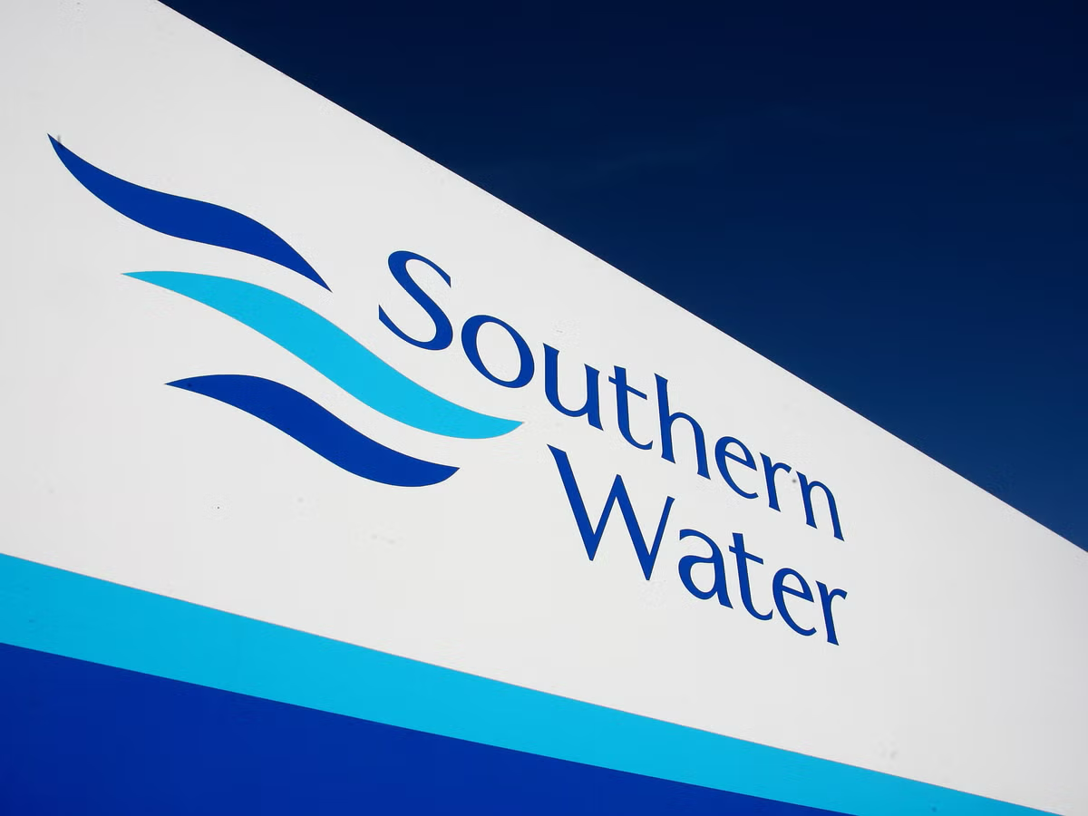
Southern Water Corp.
Financial Analysis & Profit Optimization for the Period of June 2013 to July 2014.
Presented by Ariel Farelas
Springboard
October 05, 2025
Notes:
1234566

Slide 2
Executive Summary
Optimize chemical procurement, mainly with Surjek.
Enhance operational efficiency: Apply Kootha’s cost model to Surjek’s operations.
Diversify revenue base: Increase residential sales penetration to balance revenue mix.
Monitor Unit Profitability Monthly.
Notes:
In this executive summary... introduce the objectives
1) Optimization of chemical procurement on Surkjek
2)Enhanced Operational efficiency: Koothas model on Surjek
3)explored revenues diversification: Increase residential sales to balance revenue mix
4)Monitor unit profitability

Slide 3
Private Water Hedge Sales lead overall revenues, contributing $187M, followed by Public Sales ($147M) and lastly Residential Sales ($102M).
Key Revenue Insights
Notes:
Private water herdge sales main product leading overall revenues (187M)
Public sales represented the 2nd place in overall revenues with 147M
lastly Residential sales (102M)

Slide 4
Surjek drives half of all company sales ($202M), with Jutik close behind ($164M) and Kootha ($71M)
Unit Level Revenue Trends
Notes:
Visualize in this line charts the different product distribution of each water desalinator
Where Surjek leads with 202M of the company sales
Jutik again as second position with 164M
and lastly Kootha with 71M

Slide 5
Targeted Expense Analysis reveals an interesting trend; Overall Costs sharply increase from December, with Surjek, contributing $179M (56%) towards the overall cost-base.
Cost Overview
Notes:
Targeted expense analysis reveals an interesting trend, showing that overall costs increase in december, with Surjek contribuiting mainly to the overall costs which were the 56% total, translated into 179M (as showcased on the left)
Also determined the aggregated costs per accounting code centre element with labor being the main cost stream followed by Chemical expences.

Slide 6
Further analysis singles-out that Surjek with $179M (56%) worth of expenses, contrasted to a much lower spend from Kootha ($51 M) and Jutik ($91M), largely due to lower Chemical and Labour Expenditure.
Cost Breakdown by Unit
Notes:
A cost breakdown by unit was carried out
where Surjek with 179M (56)% worth of costs, contrasted vastly with Kootha (51M) and Jutik (91M), mainly due to lower chemical; expenses and labor expenditure.
top right bar chart indicate a problem

Slide 7
Drilling-down to the cost-element level, reveals an indicative relationship between water production and chemical expenditure with this being particularly pronounced for the Surjek Unit which coincidentally has the highest rate of water production.
Operational Efficiency
Notes:
Operational efficiciency was determined by drilling down to cost-element level, revealing a correlation between chemical expenditure and water production, being significantly larger on Surjek, which was the highest rate of water production unit

Slide 8
Concluding our analysis, Jutik has the highest overall EBIT contributions ($73M), followed by Surjek ($23M), and lastly Kootha ($20M). However, from an EBIT Margin (%) perspective, Kootha has a higher margin than that of Surjek, indicative of a lower revenue-to-expense ratio.¹
Operational Efficiency
Note:¹ We can clearly see for Surjek over the October, November and May Periods – expenses were far higher than revenues which contributed to this lower revenue-to-expense ratio.
Notes:
Further into the operational efficiency, we conclude that Jutik has highest overall EBIT contribution (of 73M) followed by surjek (23M)and lastly Kootha (20M)
Nevertheless, EBIT margin percentage wise, Kootha has a higher margin than surjek, explained by a lower revenue-to-costs ratio.

